Slide 1

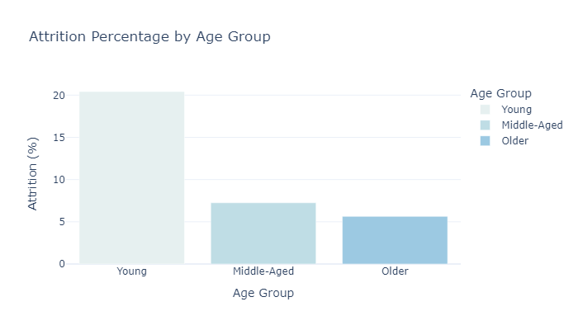
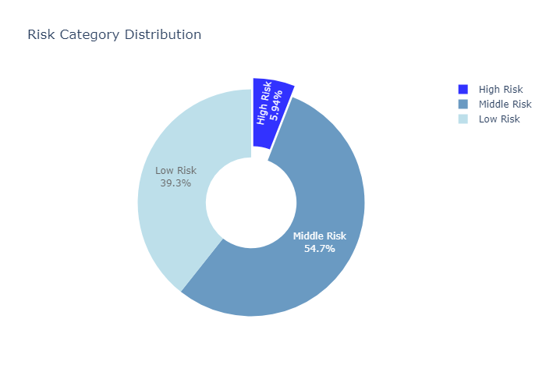
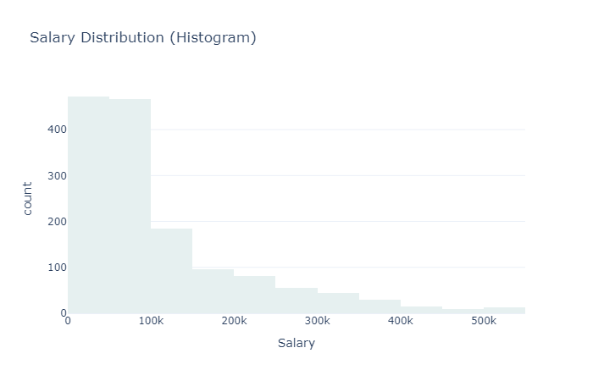
Beyond Attrition: What’s Driving Workforce Changes at Atlas Lab??
Active Employees Count
1233
Attrition Percentage
16.12%
Employees Average Satisfaction
3.36
Raghad Al-Allan
BUSINESS CONTEXT
California, renowned for its innovation and economic prowess,faces significant challenges with employee attrition. The state experiences one of the highest employee turnover rates in the nation, with an overall turnover rate of approximately 12.9%. (MaisonLaw)
This project studies employee attrition at Atlas Lab, focusing on factors like salary differences, employee satisfaction, and turnover rates by department. By analyzing demographics, satisfaction scores, and past attrition data, the goal is to identify the main causes of employee turnover. The insights will help suggest strategies to reduce attrition and improve retention at Atlas Lab.
ANALYSIS
Employee distribution by gender, age, and ethnicity revealed a diverse workforce, with a predominantly young employee base 64.5%.
The salary distribution shows that most employees earn salaries in the lower to middle range (50K-100K), with only a few earning much higher salaries.Higher salaries are linked to higher job satisfaction.
Sales had the highest attrition rate at 20.62%, followed by human resources at 19.04%, and technology at 13.84%. Additionally, the attrition rate was highest among employees under 30 (20.42%).
Environment Satisfaction is generally high across all departments, with scores between 3.741 and 3.819. However, Job Satisfaction is particularly low in Human Resources, with an average score of 3.1. Relationship Satisfaction is the lowest in Sales (3.29).
A simple attrition risk prediction model identified 53 employees at high risk of attrition based on factors like Age, Job Satisfaction, Relationship Satisfaction, and Work-Life Balance.
Predicting Employee Attrition Risk:
Employees are categorized into High Risk, Middle Risk, and Low Risk based on factors like job satisfaction and work-life balance. Those with more risk factors are at higher risk of leaving. This model helps identify employees who may need attention to improve retention.
Actionable Insights:
Focus on improving job satisfaction and work-life balance to reduce attrition risk.
Tailor retention strategies for high-risk departments, especially Sales and HR.
Use the risk categories to proactively engage employees at risk of leaving.

